Slide 1
Generative AI For Engineering
Final Project
Submitted By:
Name : Sai Prasath.S
Register No: 813821104083

Slide 2
PROJECT TITLE
Health Chat Bot
Powered By AI

Slide 3


AGENDA
Problem Statement
Project Overview
Who Are The End Users?
Solution And its Value Proposition
WOW in Solution
Modeling
Results
3/21/2024 Annual Review

Slide 4

PROBLEM STATEMENT
Developing a Health Support Chat Bot powered by AI to provide immediate responses to health-related queries, aiming to enhance accessibility to reliable health information and alleviate burden on traditional healthcare systems

Slide 5

PROJECT OVERVIEW
Our project aims to develop a Health Support Chat Bot powered by AI, offering immediate responses to health-related queries. Leveraging advanced natural language processing algorithms, the chatbot provides personalized assistance, reliable information, and continuous learning capabilities. By integrating seamlessly with existing healthcare systems, the chatbot seeks to empower individuals to make informed decisions about their health and alleviate pressure on traditional healthcare services.

Slide 6

WHO ARE THE END USERS?
The Health Support Chat Bot powered by AI serves a diverse range of end users, offering immediate responses to health-related queries. Individuals seeking information on symptoms, treatments, and preventive measures can access personalized guidance anytime, anywhere. Caregivers and healthcare professionals also benefit from the chatbot's reliable information and recommendations. Ultimately, the chatbot aims to empower users to make informed decisions about their health and well-being, alleviating pressure on traditional healthcare services.

Slide 7

YOUR SOLUTION AND ITS VALUE PROPOSITION
Our solution, the Health Support Chat Bot powered by AI, revolutionizes access to health information and guidance. By offering immediate responses to health-related queries, personalized recommendations, and reliable information sourced from trusted databases, our chatbot empowers individuals to take control of their health journey. With continuous learning capabilities, the chatbot adapts to user interactions, ensuring accuracy and relevance in its responses. This innovative tool not only provides convenience and accessibility but also alleviates pressure on traditional healthcare services by offering round-the-clock support. Our value proposition lies in enhancing healthcare accessibility, promoting proactive health management, and ultimately improving the well-being of individuals and communities.

Slide 8

THE WOW IN YOUR SOLUTION
24/7 Availability
Portable
Trustable Data Source
Recommendation And Suggestion generator
Realtime Solution
Fast Processing
3/21/2024 Annual Review

Slide 9
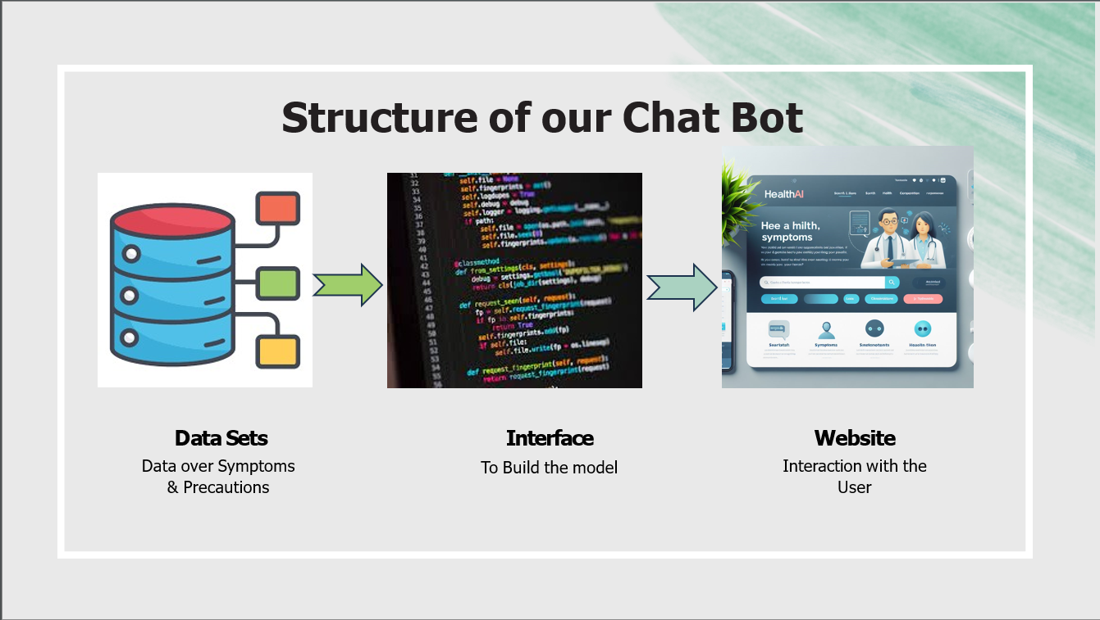
MODELLING

Slide 10
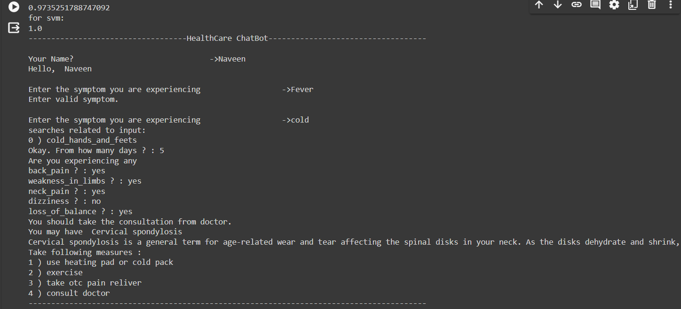
RESULTS
https://github.com/SaiPrasath342/TNSDC_GenAI_Projects.git

